Slide 1

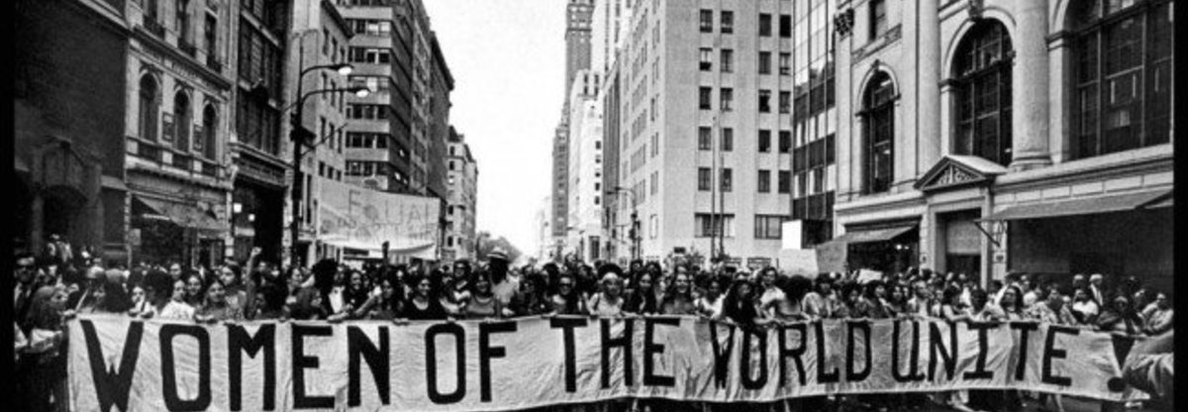

VIOLENCE AGAINST WOMEN AND TURKEY
Buğrahan Kadir Sarıca – 11020060516
Meltem Akkoca - 31598286002
Yakupguly Malikov - 99663372432
Berkay Dursun - 16286273106

Slide 2

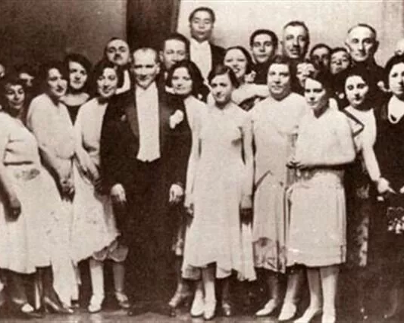
Description Of The Problem
We are wondering how much our country’s violence rate and how much it differs from other countries. We will make a comparison between Turkey, African countries, Asian countries and South American countries. Furthermore, we can make some conclusions such as ‘X’ country applies the ‘Y’ and their violence rate reasonably low level when we compare with our country.

Slide 3
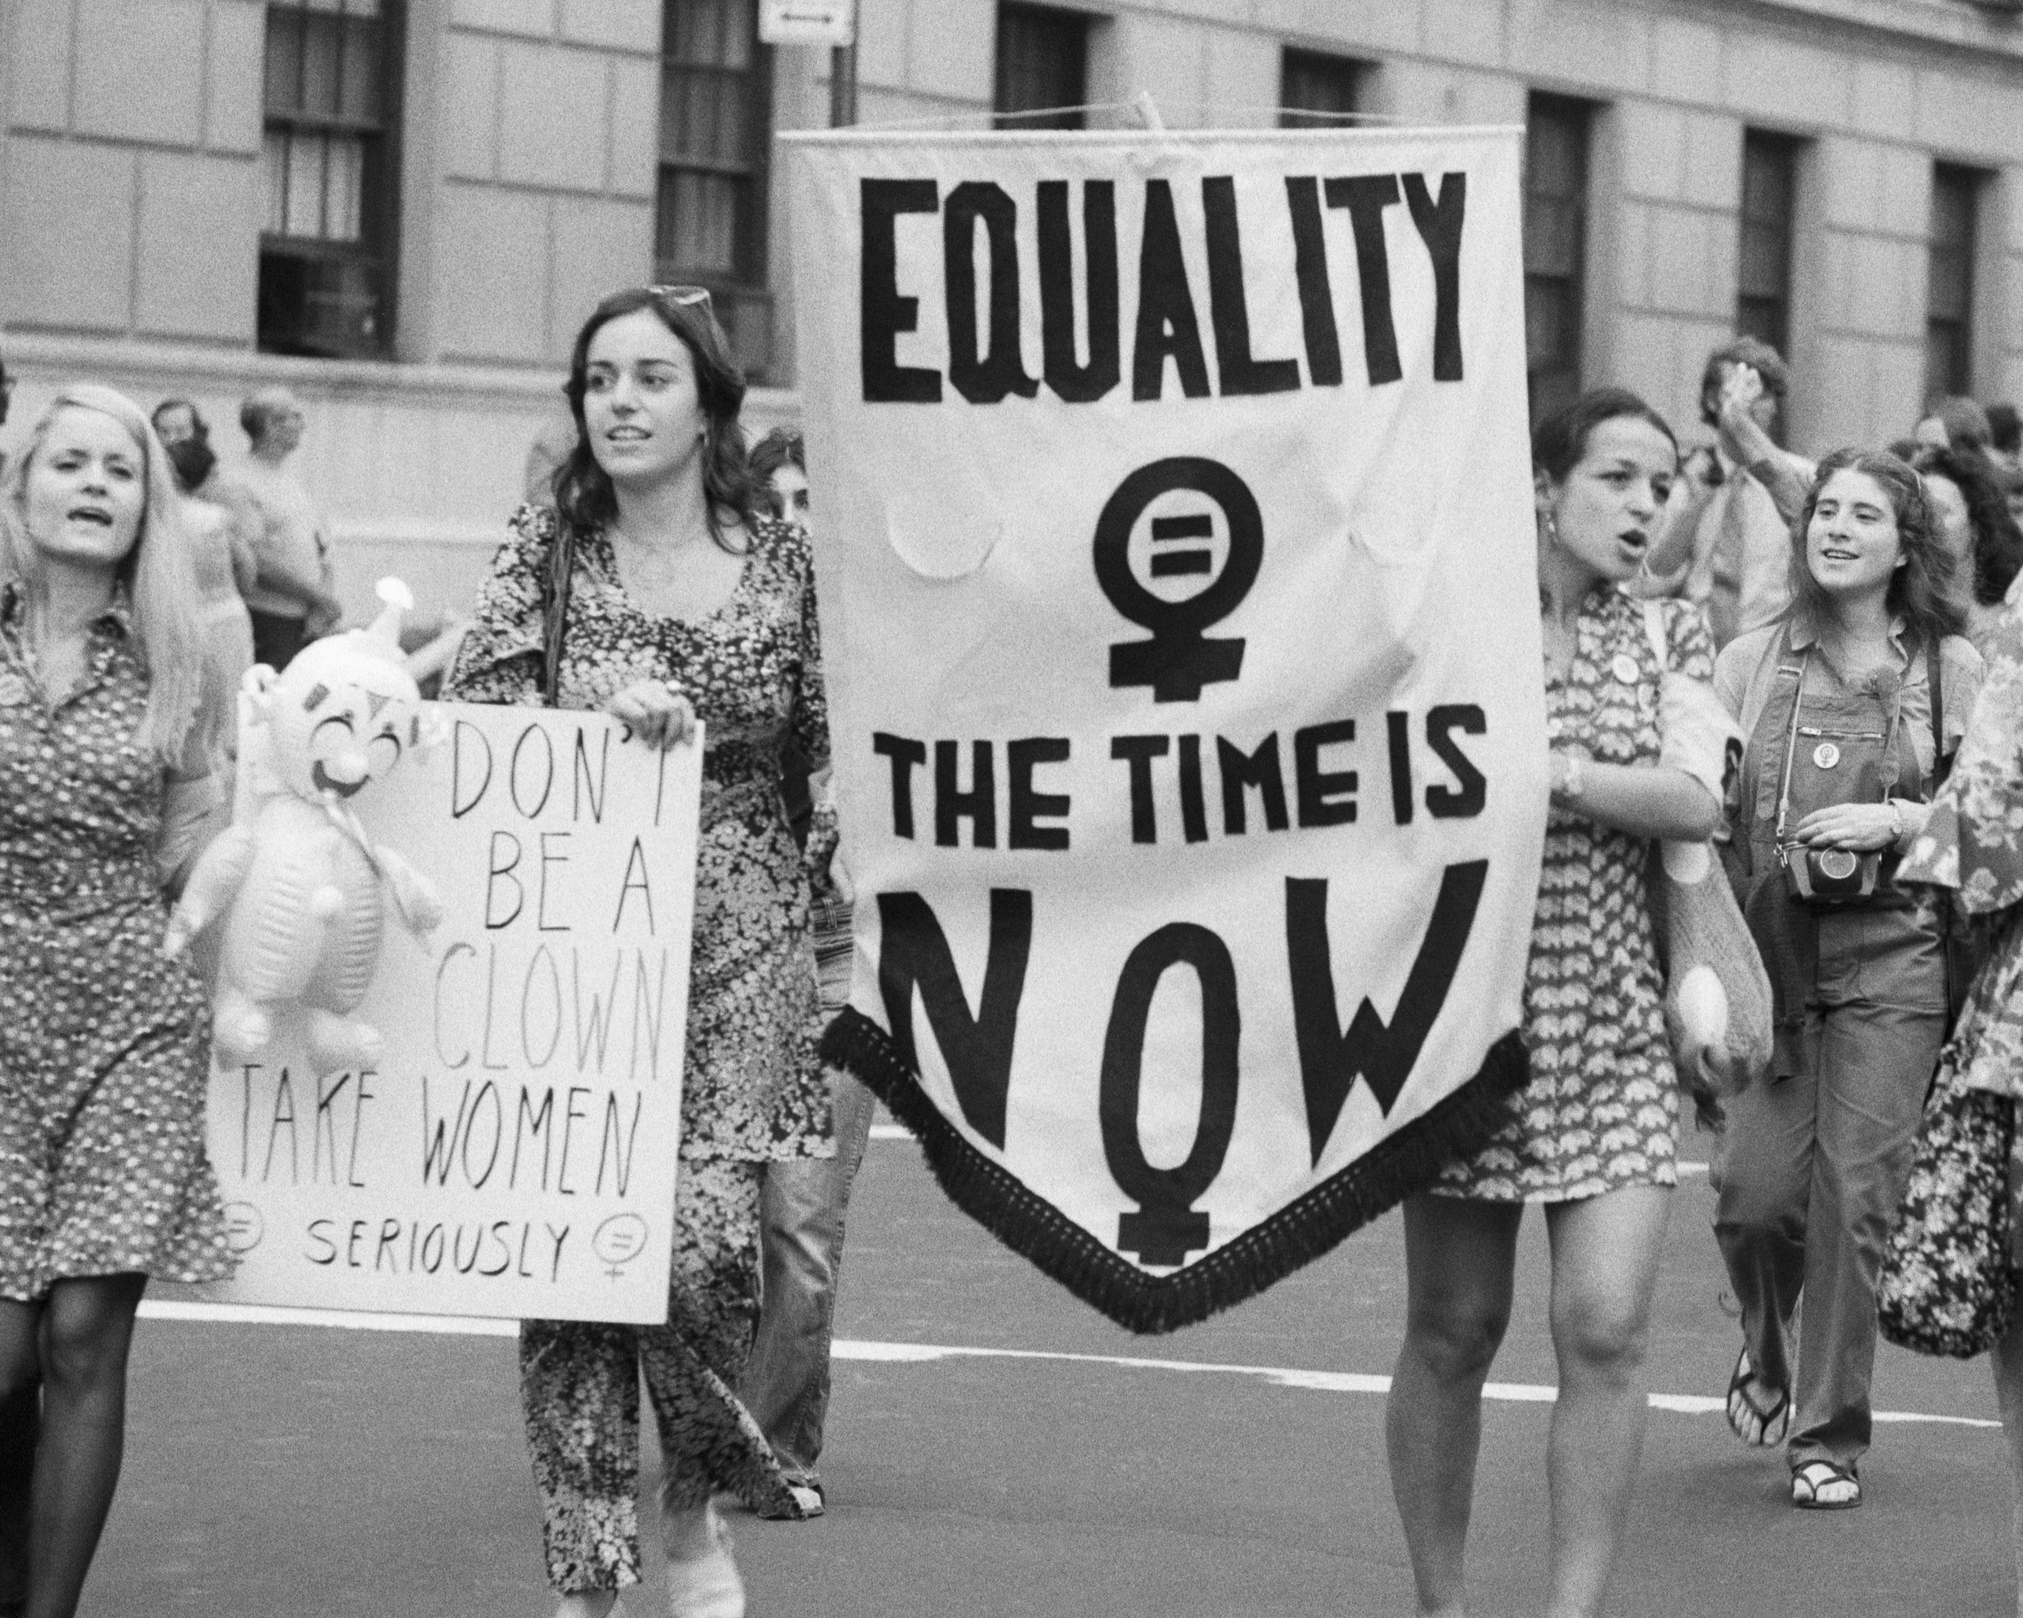
User Expectation
The effect of the factors in the processed data sets on violence against women in different countries in this situation. We can easily compare these countries and make a consequence of their values and according to their values, we can search for their approaches to this issue.

Slide 4
General Information
We found the dataset from Kaggle. The title of the Kaggle project is “Violence Against Women and Girls” (Larxel,2020). Kaggle writer takes the data from The Demographic and Health Surveys (DHS).

Slide 5
Model of Data Warehouse
We thought that the star schema would be more logical due to the small number of columns in the data set.

Slide 6
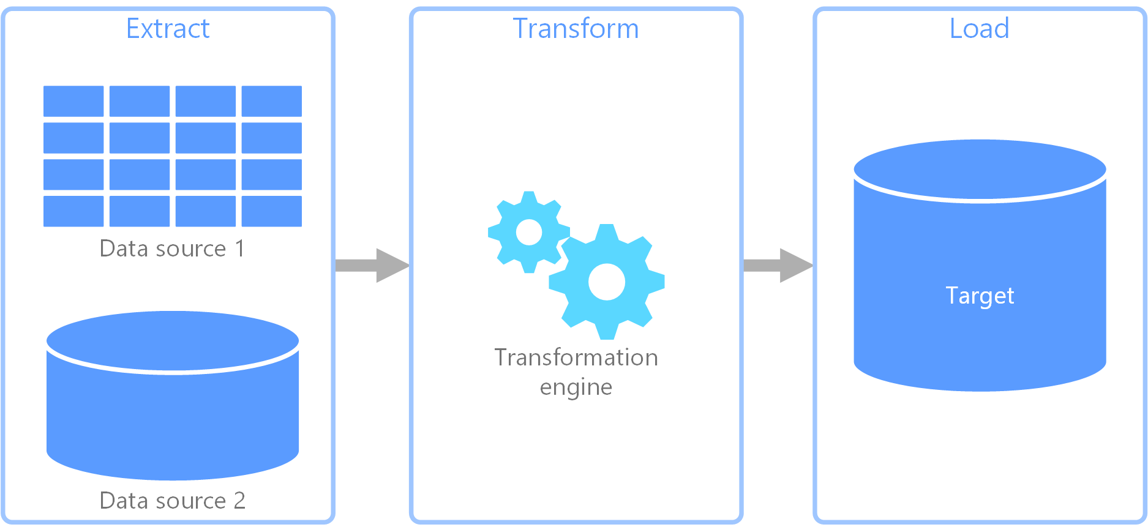
ETL Operations
Extractions
We used the dataset violence against women and girls from Kaggle that we mentioned in the first step, and since this dataset is very comprehensive and there are many observations from different countries, we did not need an extra dataset for the extraction stage.

Slide 7
ETL Operations
Transformations
Our data was generally compatible within itself, so we removed survey year and record ID dimension tables from the dataset in order to reduce the curse of dimensionality during the transformation phase, as they did not have a role in the project we were aiming for.

Slide 8
ETL Operations
Loading
Since we are going through a single dataset, we use the Pandas library of the Python library instead of SQL to create our csv dataset; We have performed our cleaning, transformation and loading operations here.

Slide 9
Data Pre-processing Method
Dimension Reduction
There were survey year and record id dimensions in the data we found and wanted to use. In order to keep the most recent data we can find and not to depend on the record IDs (we have already removed the dimensions that we do not need while data mining).

Slide 10
Data Pre-processing Method
Data Cleaning
At the same time, we reduced duplicate values and cleaned up unnecessary observations. There were too many missing values in our data, so in order to fix these missing values, we filled attribute mean for all samples based on other observations instead of missing values, so we used data cleaning methods in cleaning the data containing missing values.

Slide 11
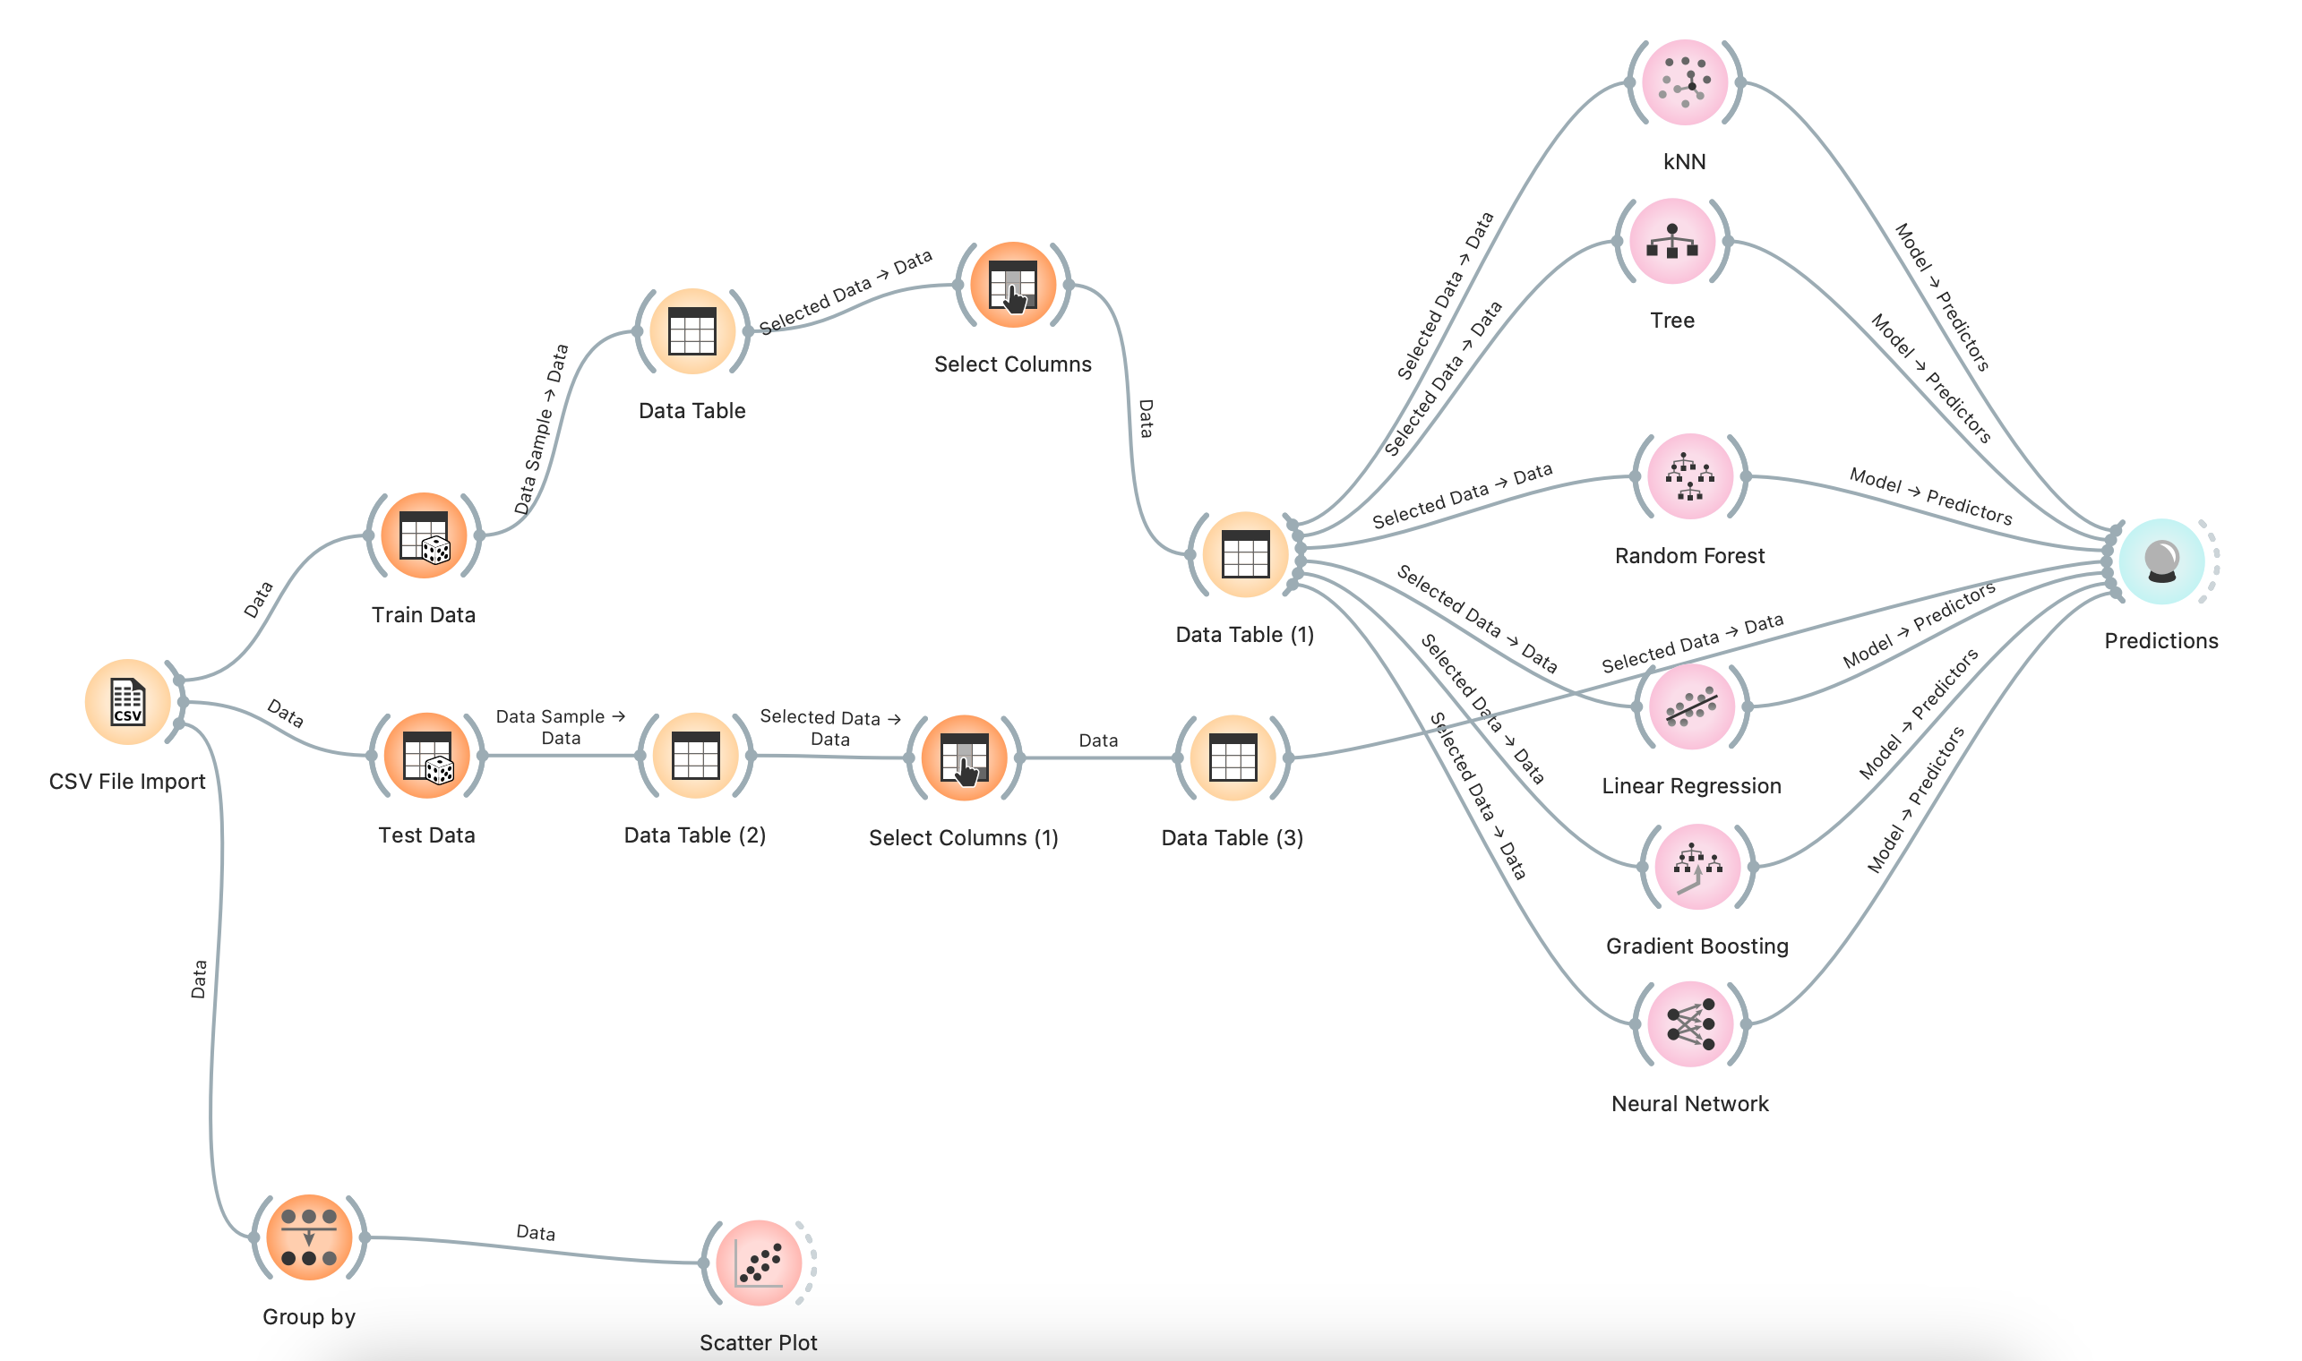
General Structure Of The Orange

Slide 12
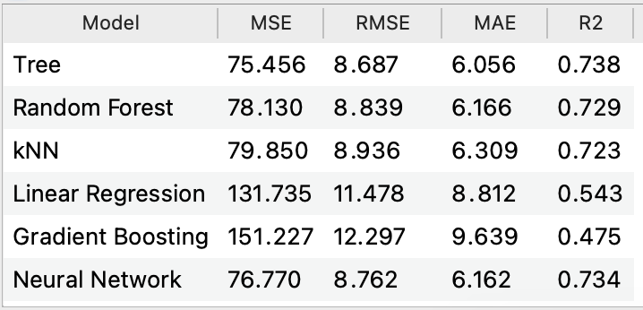
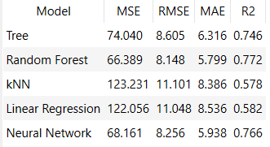
Results Of The Model
In the pre-process, null values replaced by the mean of features.
In the pre-process, null values deleted version.

Slide 13
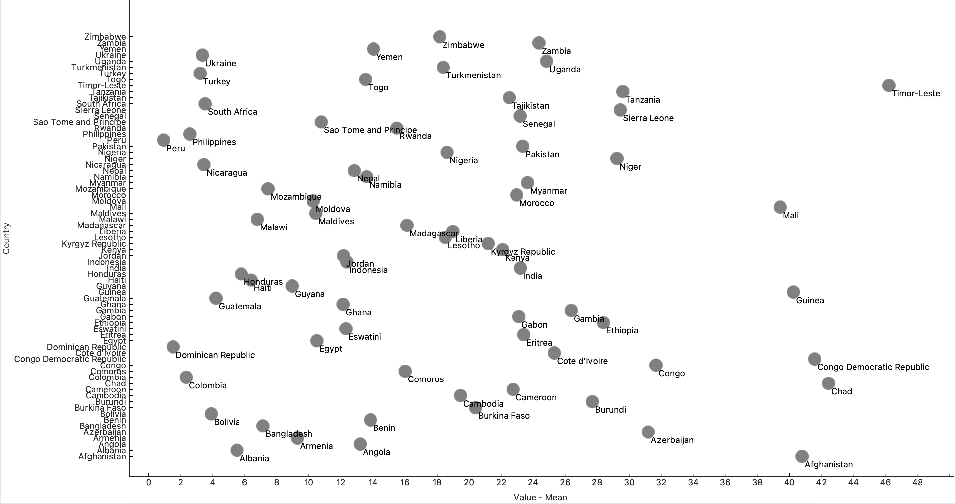
Scatter Plot Of The Countries

Slide 14


Women’s Rights in The Turkish Constitution 1982 (rev. 2017)
Minors, women and persons with physical or mental disabilities, shall enjoy special
protection with regard to working conditions.
Men and women have equal rights. The State has the obligation to ensure that thisequality exists in practice. Measures taken for this purpose shall not be interpreted ascontrary to the principle of equality.

Slide 15

Women’s Rights In The Bolıvıa Constitution 2009
The Republic of Bolivia adopts a participatory democratic, representative and communal form of government, with equal conditions for men and women.
Everyone, in particular women, have the right not to suffer physical, sexual or psychological violence, in the family as well as in the society.
Women have the right to a safe maternity, with an inter-cultural practice and vision; they shall enjoy the special assistance and protection of the State during pregnancy and birth and in the prenatal and postnatal periods
The State shall promote the incorporation of women into the workforce and shall guarantee them the same remuneration as men for work of equal value, both in the public and private arena.
Women shall not be discriminated against or fired because of their civil status, because of pregnancy, because of their age or physical features, or because of the number of children they have. It is guaranteed that pregnant women and parents cannot be dismissed from employment until the child completes one year of age.
Women and men are guaranteed the exercise of sexual rights and their reproductive rights.
The equal participation of men and women shall be guaranteed in the election of the members of the assembly.

Slide 16

Women’s Rights In The Dominic Republic Constitution 2015
Women and men are equal before the law. Any act that has the objective or result of diminishing or annulling the recognition, enjoyment or exercise of fundamental rights of woman and men in conditions of equality is prohibited
The State should promote and guarantee the equal participation of women and men in candidate lists to the offices of popular election for the instances of guidance and decision in the public sphere, in the administration of justice, and in the State-controlled bodies
Familial and gender based violence in any of its forms is condemned. The State shall guarantee through the law the adoption of necessary methods to prevent, sanction, and eradicate violence against women.
The State guarantees the equality and equity of women and men in the exercise of the right to work.

Slide 17

Women’s Rights In The Colombia Constitution 2015
The authorities shall guarantee the adequate and effective participation of women in the decision-making ranks of the public administration.
Women and men have equal rights and opportunities. Women cannot be subjected to any type of discrimination. During their periods of pregnancy and following delivery, women shall benefit from the special assistance and protection of the State and shall receive from the latter food subsidies if they should thereafter find themselves unemployed or abandoned.

Slide 18

Women’s Rights In The Peru Constitution 1993 (rev. 2021)
The law determines the minimum percentages to facilitate representation of women, rural and indigenous communities, and aboriginal peoples in regional councils. The same applies for municipal councils.

Slide 19

Women’s Rights In The Ukraine Constitution 1996 (rev. 2019)
Equality of the rights of women and men is ensured: by providing women with opportunities equal to those of men, in public and political, and cultural activity, in obtaining education and in professional training, in work and its remuneration; by special measures for the protection of work and health of women; by establishing pension privileges, by creating conditions that allow women to combine work and motherhood; by legal protection, material and moral support of motherhood and childhood, including the provision of paid leaves and other privileges to pregnant women and mothers.
The employment of women and minors for work that is hazardous to their health, is prohibited.

Slide 20

Women's Rights In The Egypt Constitution 2014 (rev. 2019)
The state commits to achieving equality between women and men in all civil, political, economic, social, and cultural rights in accordance with the provisions of this Constitution.
The state commits to the protection of women against all forms of violence, and ensures women empowerment to reconcile the duties of a woman toward her family and her work requirements.
The House of Representatives is composed of no less than four hundred and fifty members elected by direct secret public ballot. At least one quarter of the seats shall be allocated to women.

Slide 21

Women's Rights In The Philippines Constitution
Equality before the law – Women and men are equal before the law. Women have the legal right to enter contracts, own property, and choose their place of residence.
Marriage and family – Women have equal rights with men in matters related to marriage and family relations.

Slide 22

Women's Rights In The Nicaragua Constitution
Unconditional equality of all Nicaraguans in the enjoyment of their political rights, in the exercise of these rights, and in the fulfillment of their duties and responsibilities, is established; there exists absolute equality between men and women.
The State grants special protection to the process of human reproduction. Women shall have special protection during pregnancy and shall be granted maternity leave with pay and all appropriate social security benefits. No one may deny employment to women for reasons of pregnancy nor dismiss them during pregnancy or the post-natal period; all in conformity with the law.

Slide 23

Women's Rights In The Guatemala Constitution
Men and women have equal ownership rights to immovable property
Age of men and women can retire with full pension benefits is same

Slide 24

Women's Rights In The Honduras Constitution
Special protection shall be given to women and minors. A woman is entitled to leave before and after childbirth, without loss of employment or wages. During the nursing period she shall be entitled to a rest period each day for nursing her child. The employer may not terminate the employment contract of a pregnant woman, nor after childbirth, except after having proved just cause before a competent judge, in the cases and conditions indicated by law.

Slide 25

Women's Rights In The Haiti Constitution
To assure to women a representation in the instances of power and of decision which must conform to the equality of the sexes and to equity of gender.
The principle of the quota of at least thirty percent (30%) of women is recognized at all levels of national life, notably in the public services.

Slide 26

Women's Rights In The Bangladesh Constitution
Provided that nothing in this clause shall be deemed to prevent a woman from being elected to any of the seats provided.
The State shall endeavour to ensure equality of opportunity and participation of women in all spheres of national life.
Women shall have equal rights with men in all spheres of the State and of public life. Nothing in this article shall prevent the State from making special provision in favour of women or children or for the advancement of any backward section of citizens.

Slide 27

Women's Rights In The Malawi Constitution
Principles of national policy To obtain gender equality through;
full participation of women in all spheres of Malawian society on the basis of equal opportunities with men; Family and marriage All men and women have the right to marry and found a family Rights of women Women have the right to full and equal protection by the law, and have the right not to be discriminated against on the basis of their gender or marital status which includes the right
to be accorded the same rights as men in civil law, including equal capacity
to enter into contracts; to acquire and maintain rights in property, independently or in association with others, regardless of their marital status; to acquire and retain custody, guardianship and care of children and to have an equal right in the making of decisions that affect their upbringing; and to acquire and retain citizenship and nationality. on the dissolution of marriage, howsoever entered into to a fair disposition of property that is held jointly with a husband; and to fair maintenance, taking into consideration all the circumstances and, in particular, the means of the former husband and the needs of any children.
Any law that discriminates against women on the basis of gender or marital status shall be invalid and legislation shall be passed to eliminate customs and practices that discriminate against women, particularly practices such asexual abuse, harassment and violence; discrimination in work, business and public affairs; and deprivation of property, including property obtained by inheritance.

Slide 28
References
https://www.constituteproject.org/
https://www.kaggle.com/datasets/andrewmvd/violence-against-women-and-girls
https://www.worldometers.info/

